Slide 1

https://www.pinterest.com.mx/pin/296604325450925256/

Slide 2

https://www.pinterest.com.mx/pin/513903007469755407/

Slide 3
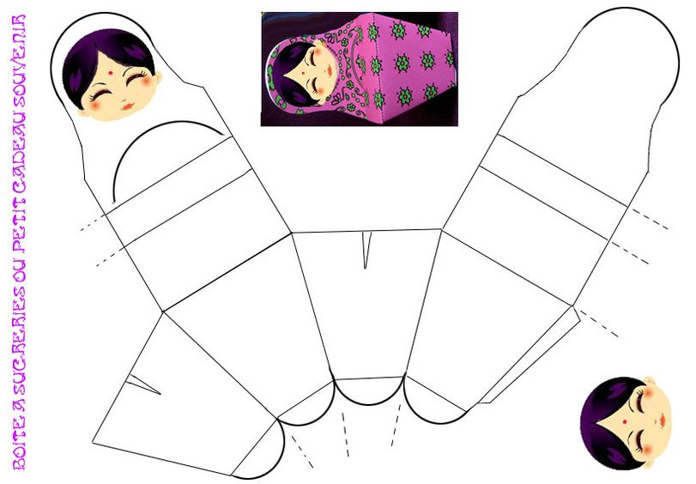
https://www.pinterest.com.mx/pin/399201954462743044/

Slide 4
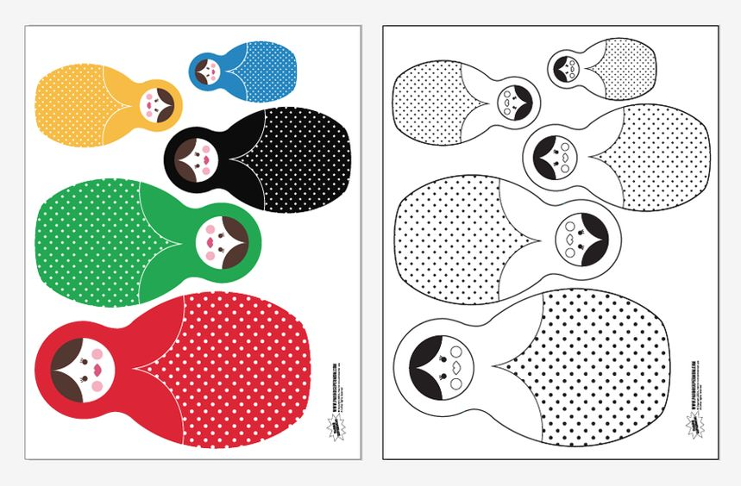
https://www.pinterest.com.mx/pin/130393351685683855/

